Slide 1

OPTICAL CHARACTER RECOGNITION
ABHISHEK SINDAGI
2GI20EC007

Slide 2
OPTICAL CHARACTER RECOGNITION
the process that converts an image of text into a machine-readable text format.
Optical character recognition (OCR), a revolutionary technique, allows the conversion of printed or handwritten text into a machine-readable format.
It is essential for many different fields, such as document digitalization, data extraction.

Slide 3
CLASSIFICATION
With the help of OCR, people no longer need to manually retype important documents when entering them into electronic databases.
OCR extracts relevant information and enters it automatically.
OCR means it is a Machine Learning problem where the output is categorical (i.e. it belongs to a finite set of values).

Slide 4
IMPORTANCE OF OCR
The majority corporate operations include information gathering from print media. Business procedures include the use of printed contracts, scanned legal documents, invoicing, and paper forms.
Text in images cannot be processed by word processing software in the same way as text documents.

Slide 5
APPLICATIONS OF OCR
OCR is frequently used to digitise paper documents, including printed papers, books, invoices, and forms, into digital representations.
OCR makes it possible to extract text from photographs or scanned documents, allowing for text analysis and processing
By obtaining data from forms, questionnaires, surveys, and other structured documents, OCR automates data entering activities.

Slide 6
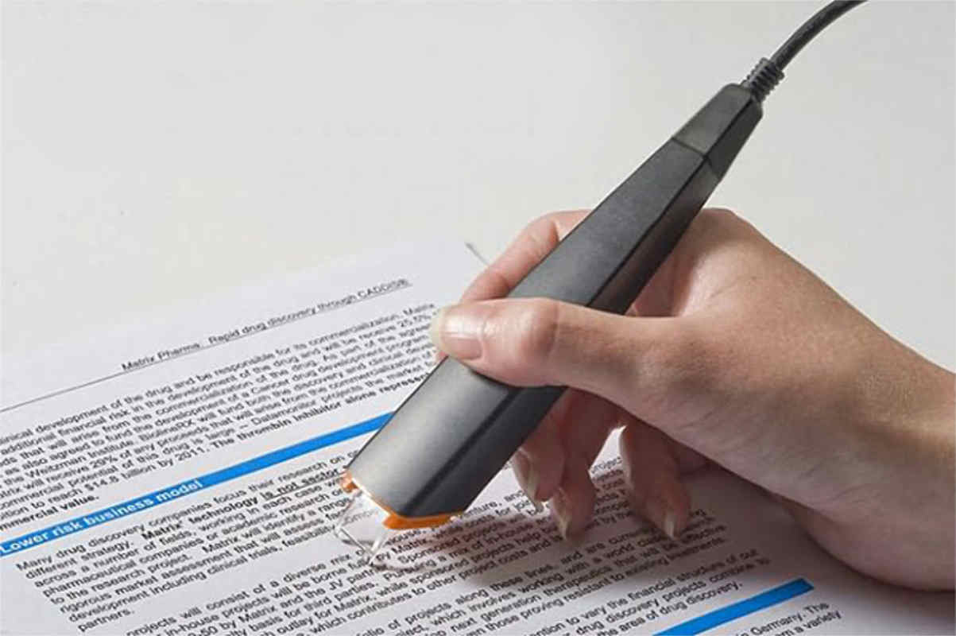
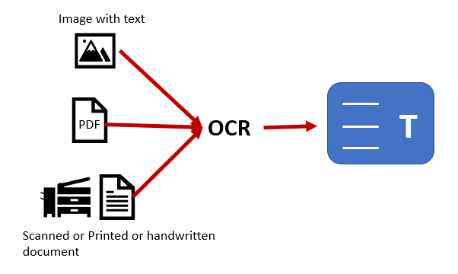
APPLICATIONS OF OCR

Slide 7
APPLICATIONS OF OCR
OCR is essential to the process of digitising books and libraries. It makes it possible to digitise printed books.
OCR is used in Automatic Licence Plate Recognition (ALPR) systems to automatically identify vehicle licence plates.
OCR technology is utilised for handwriting recognition in addition to reading printed text.

Slide 8
DISADVANTAGES OF OCR
OCR systems are expensive.
he quality of the image can be lose during this process.
Not 100% accurate, there are likely to be some mistakes made during the method.
OCR struggles with processing unstructured text formats and handwriting.

Slide 9
CONCLUSION
Textual data may be effectively saved and retrieved by digitising printed or handwritten text using optical character recognition (OCR), a powerful technique.
OCR methods have considerably improved over time, thanks to developments in computer vision, deep learning, and machine learning.

Slide 10
THANK YOU
SUBMITTED BY
2GI20EC007
ABHISHEK SINDAGI

